Slide 1


DEPARTMENT OF COMPUTER SCIENCE AND ENGINEERING
20CS7503 & DESIGN PROJECT – III
END SEMESTER PRACTICAL EXAMINATION- NOV / DEC 2025
REVIEW PRESENTATION
Batch No. : 12
Date: 01.12.2025
Session: FN

Slide 2
AI-POWERED PHISHING DETECTOR
Guide Name:
Mr. D. P. Devan, Assistant Professor,
Department of CSE
Team Members:
R. Aravinth Krishna (811722104012)
K. Arun (811722104016)
M. Jayanan (811722104062)

Slide 3
OBJECTIVE OF THE PROJECT
To design a browser-based AI system that detects phishing websites in real time.
To integrate ML classification with HTTPS and domain-based checks for accuracy.
To ensure safe and seamless browsing with a lightweight, secure Chrome Extension.
To create a centralized database that continuously learns and adapts from new phishing patterns for improved detection over time.

Slide 4
INTRODUCTION
Phishing is one of the most common and dangerous online threats targeting user data.
Traditional blacklist systems fail to detect newly launched phishing sites.
AI models can analyze URL patterns and anomalies to detect suspicious links.
Our Chrome Extension integration offers instant, on-page phishing alerts to users.
The system merges AI, HTTPS validation, and database checks for better reliability.

Slide 5
LITERATURE SURVEY
TITLE OF PAPER | AUTHOR(S) | PAPER GIST | TECHNOLOGY USED
Phishing or Not Phishing? A Survey on the Detection of Phishing Websites | V. Vignesh, S. B. Goyal, R. Maheswari | IEEE Access, 2023 | Covers blacklist/whitelist methods, similarity-based detection, ML and DL approaches for phishing detection
A Survey of Intelligent Detection Designs of HTML URL Phishing Attacks | H. Chen, J. Xu, Y. Zhang | IEEE Access, 2023 | Intelligent phishing detection using URL/HTML feature engineering, Machine Learning, Deep Learning

Slide 6
TITLE OF PAPER | AUTHOR(S) | PAPER GIST | TECHNOLOGY USED
Malicious URL Detection using Machine Learning: A Survey | M. Sahoo, S. Liu, E. H. Camtepe | ACM Computing Surveys, 2023 | Survey of ML methods (SVM, Random Forest, Logistic Regression), feature extraction (lexical, host, content-based)
A Survey of Phishing Attacks: Their Types, Vectors and Technical Approaches | M. A. Moghimi, A. Y. Varjani | Expert Systems with Applications (Elsevier), 2018 | Phishing detection strategies, feature-based approaches, Machine Learning techniques, technical defenses

Slide 7
EXISTING SYSTEM ARCHITECTURE
Depends mainly on static blacklist and whitelist databases.
Updates from external sources cause delay in detecting new phishing URLs.
No AI-based prediction or adaptive detection layer present.
HTTPS checks are limited or completely missing in many tools.
Results in slower response and higher chances of phishing success.

Slide 8
PROBLEM IDENTIFICAITON
1. Existing system fails to identify newly created phishing sites.
2. Dependence on third-party databases delays warning generation.
3. Absence of dynamic learning reduces accuracy.
4. Limited HTTPS verification affects trust assessment.
5. No single lightweight solution integrates all key detection layers.

Slide 9
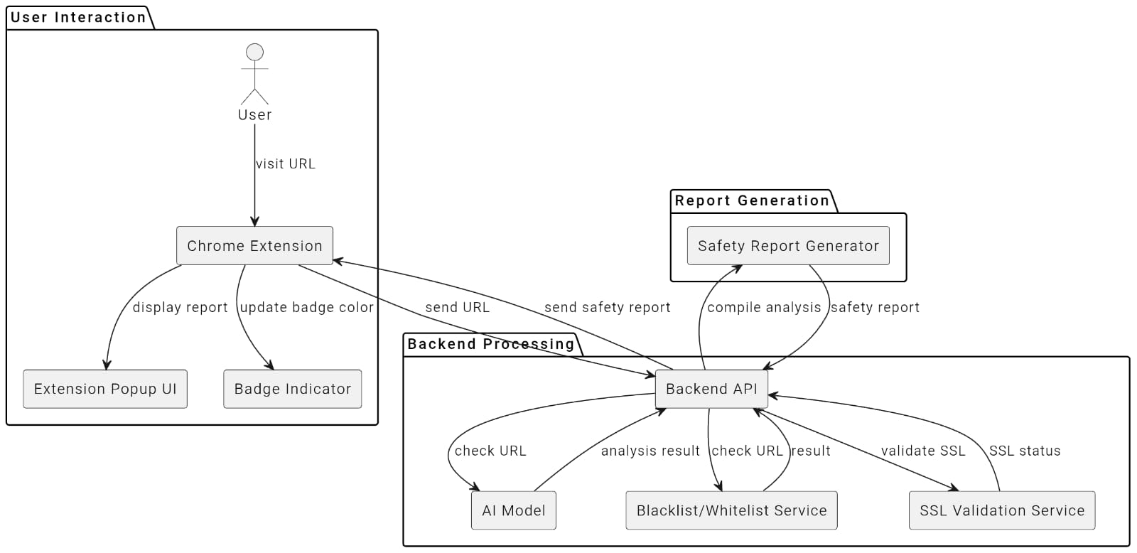
PROPOSED SYSTEM ARCHITECTURE

Slide 10
SOFTWARE AND HARDWARE REQUIREMENTS
HARDWARE
1. 4 GB RAM
2. Intel i3 Processor or above
3. CPU Dual-core or higher
4.Strorage 500 MB(development)
SOFTWARE
1. Chrome Browser & Extension Developer Tools
2. Python (FastAPI ,scikit-learn)
3. Node.js runtime

Slide 11
MODULES
1. URL Input & Monitoring Module
2. Backend API Module
3. AI Model Module
4. Blacklist/Whitelist Database Module
5. HTTPS Verification Module

Slide 12
IMPLEMENTATION OF MODULE-1
Module 1 – URL Input & Monitoring
Listens for browser tab updates and instantly captures the currently active URL for scanning.
Allows users to manually enter URLs via the extension popup and securely sends them to the backend API for analysis.
Displays a live status badge on the browser toolbar (safe, suspicious, phishing) to provide quick and clear feedback to the user.

Slide 13
IMPLEMENTATION OF MODULE-2
Module 2 – Backend API
Receives the incoming URL from the extension and extracts all required lexical, domain, and SSL-based features.
Efficiently communicates with both the AI model and Local database to deliver quick and accurate results.
Stores every scan result with timestamp and prediction details to support logging, analytics, and model improvement.

Slide 14
IMPLEMENTATION OF MODULE-3
Module 3 – AI Model
Uses a pre-trained Random Forest classifier trained on thousands of URL samples for better prediction accuracy.
Analyzes multiple attributes such as URL length, HTTPS status, suspicious characters, and domain reputation to compute phishing probability.
Returns a precise prediction score back to the backend, ensuring intelligent real-time decision-making for user safety.

Slide 15
IMPLEMENTATION OF MODULE-4
Module 4 – Blacklist/Whitelist
Maintains an updated list of verified safe domains and known malicious ones in the PostgreSQL database.
Performs rapid lookups before AI model execution to save time and reduce unnecessary computations.
Automatically updates from trusted sources and ensures consistent performance with minimal false detections.

Slide 16
IMPLEMENTATION OF MODULE-5
Module 5 – HTTPS Verification
Fetches HTTPS certificate details such as issuer, validity period, and encryption strength for each scanned URL.
Evaluates the trust level of the certificate by checking for expired, invalid, or self-signed certificates.
Flags and reports suspicious domains with poor SSL configurations to enhance browser-level phishing prevention.

Slide 17
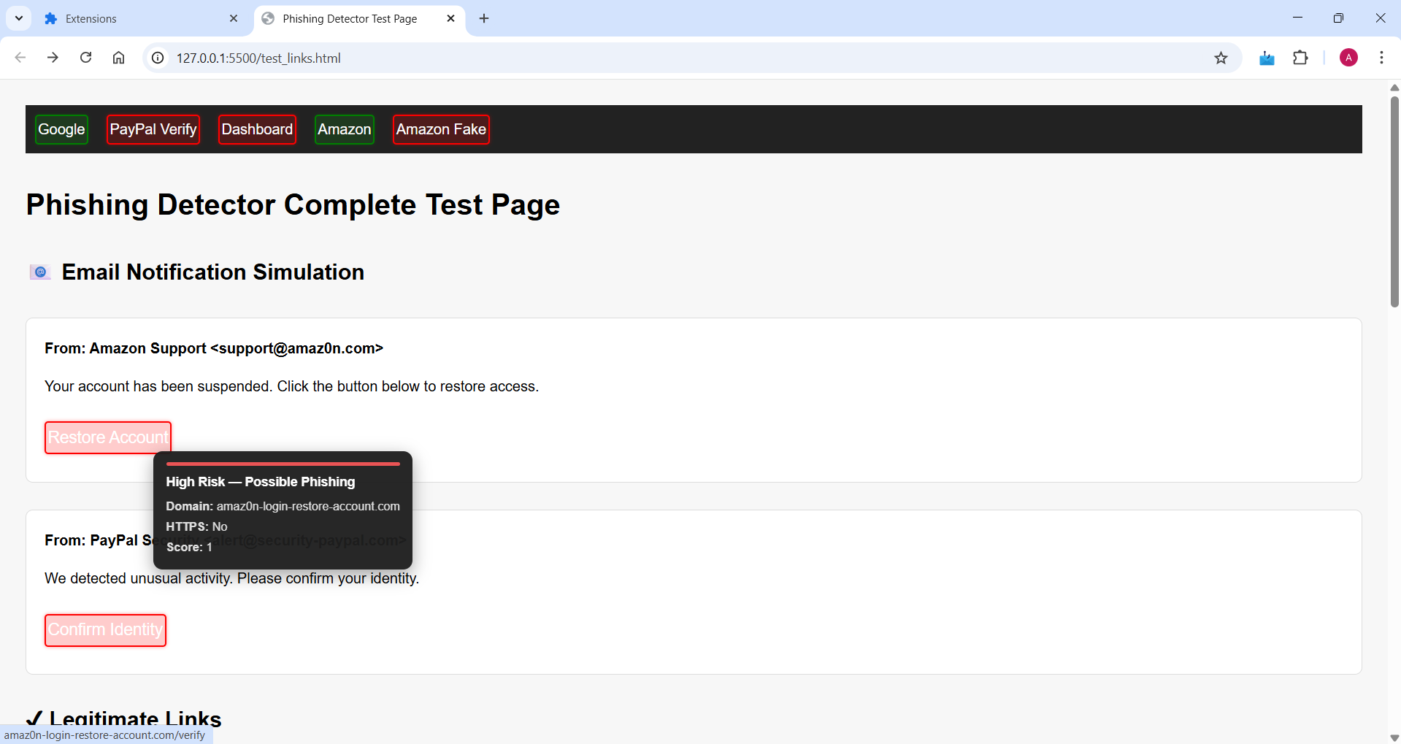

Slide 18
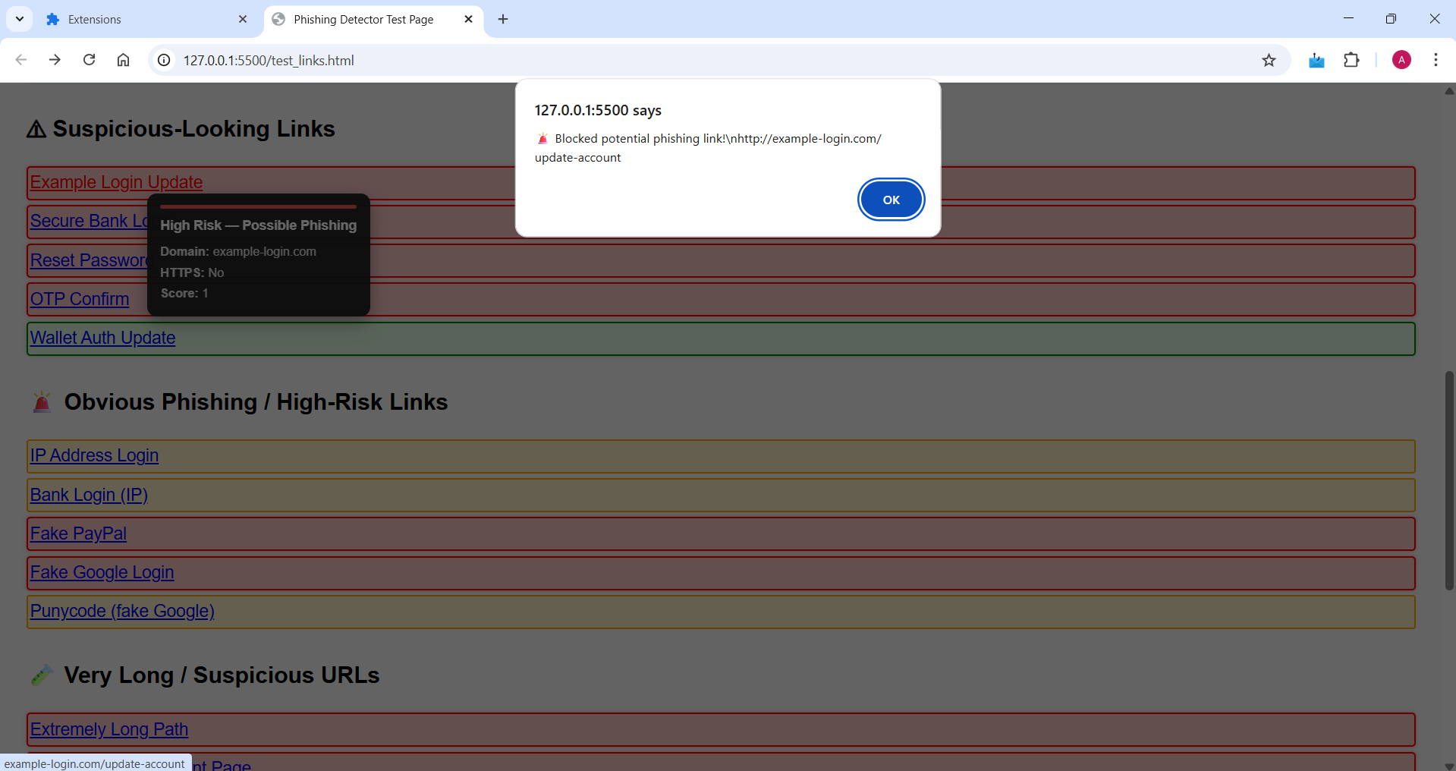

Slide 19
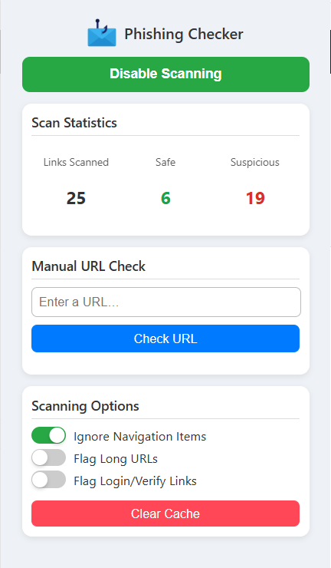

Slide 20
FUTURE ENHANCEMENTS
Integrate NLP-based content analysis to detect phishing pages through text patterns.
Use cloud-based centralized learning for faster database updates and AI retraining.
Add support for other browsers like for example Firefox, Edge, and Brave.

Slide 21
CONCLUSION
Our AI Powered Phishing Detector efficiently detects phishing websites in real time using a combination of machine learning, SSL validation, and blacklist verification.
The system ensures user safety with accurate predictions while maintaining lightweight performance through its Chrome Extension interface.
It provides a practical and user-friendly solution to tackle modern phishing threats and improves upon traditional static detection methods.

